Slide 1

Basic Knowledge On 3D Graphic
Jerome Peng

Slide 2

Contents
Section I
Introduction
Section II
Projection
Section III
Coordinate System
Section IV
Transfer
Section V
Hidden Surface
Section VI
Production

Slide 3

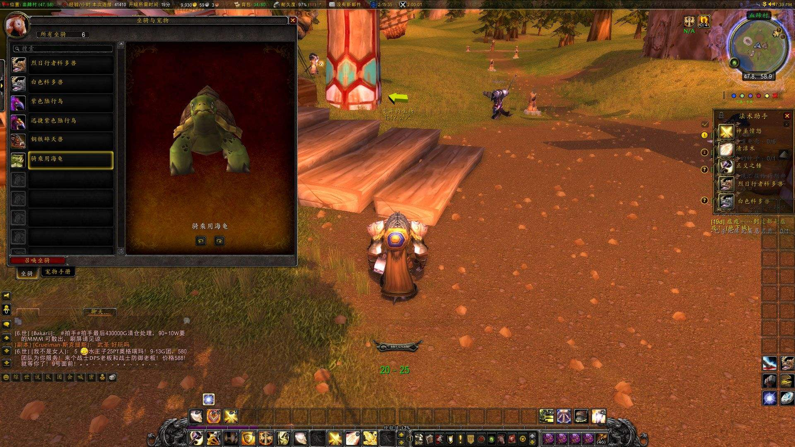
Session I
Introduction
2 types of 3D effect

Slide 4
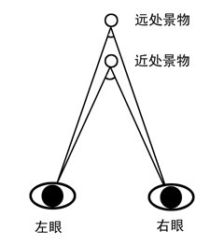
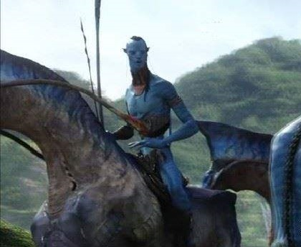
Session I
Introduction
3D movie

Slide 5
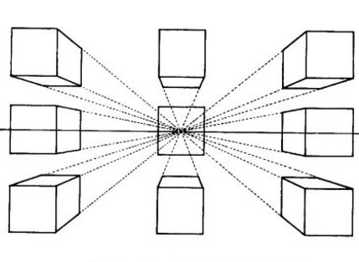
Session I
Introduction
3D game

Slide 6
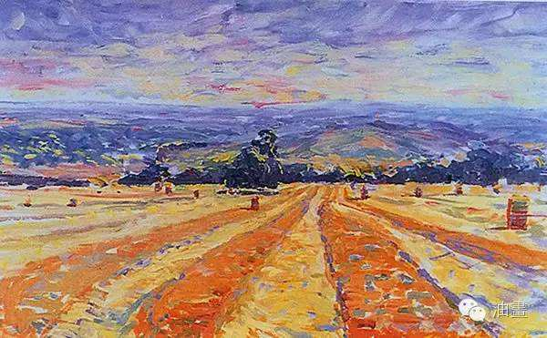
Session II
Projection

Slide 7
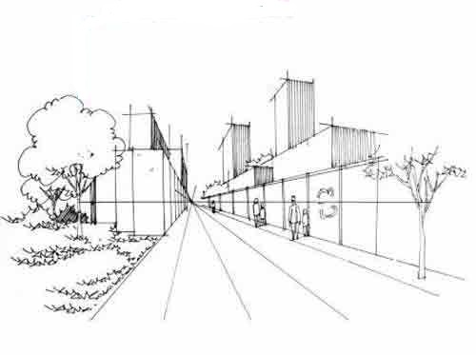
Session II
Projection

Slide 8
Session II
Projection

Slide 9
Session III
Coordinate System
z
y
x
y
x
y
x

Slide 10
Session III
Coordinate System
Key Point 1:
How to get the intersection between a line and a plane.
I used matrix to resolve this problem.
Solution as follow:
Line: p1(x1, y1, z1), p2(x2, y2, z2)
Vector of line: (vx, vy, vz) = (x2 - x1, y2 - y1, z2 - z1)
Plane: pp1(px1, py1, pz1), pp2(px2, py2, pz2), pp3(px3, py3, pz3)
Matrix:
Factor: (f1, f2, f3, f4)
Parameter: t = -((f1 + x2 * f2 + y2 * f3 + z2 * f4) / (f2 * vx + f3 * vy + f4 * vz))
Intersection: (x, y, z) = (t * vx + x2, t * vy + y2, t * vz + z2)

Slide 11
Session IV
Transfer
Key Point 2:
How to move and rotate the object.
Move:
Move an object by vector (vx, vy, vz) means move every point in the object with the vector. => (x + vx, y + vy, z + vz).
z
(vx, vy, vz)
y
x

Slide 12
Session IV
Transfer
Key Point 2:
How to move and rotate the object.
Rotate:
Rotate an object around y axis:
z
y
θ
x

Slide 13
Session IV
Transfer
Rotate an object around x axis:
Rotate an object around z axis:

Slide 14
Session IV
Transfer
Rotate an object around any axis which is parallel with x, y or z axis:
Step 1: Move the axis and object to x, y or z axis.
Step 2: Rotate the object around x, y or z.
Step 3: Move the axis and object back to his original place.

Slide 15
Session V
Hidden Surface
Key Point 3:
How to hide the objects and surfaces which shouldn't be visible.
Use mathematical way to find out which line, segment or point should be hidden one frame by one frame. It's complicate and there will be a lot of calculation which will bring performance issue.
Use Z depth to determine which surface should draw first and which surface should be draw last. It's easy to achieve and calculation will be less than the first way.

Slide 16
Session VI
Production
Git: https://github.com/jeromepeng/tetris

Slide 17
Thanks

